Slide 1
SICK PEOPLE OR SICK SOCIETIES SNOWDON’S CRITICISM OF W&P
Yanicki, Feb 11 2016
Supplemental from:
JAMES K SAKEAH(Teaching Assistant)
OCT.9, 2013

Slide 2
Overview
Reviews of the spirit level Thesis
Critique of the spirit level by Snowden and Rebuttal by Wilkinson & Pricket
Critique by other writers
conclusions

Slide 3
Learning objectives
By the end of the session you should be able to:
Critically analyze and appreciate Wilkinson & Pickett’s work
Understand the pathways through which income affects health
Appreciate other factors that impinge on health and social problems
Form an opinion on the determinants of health and wellbeing

Slide 4

Richard Wilkinson
Emeritus Professor of
Social Epidemiology
University of Nottingham
&
Kate Pickett
Professor of Epidemiology
University of York
http://www.equalitytrust.org.uk

Slide 5
Review of the spirit level Thesis
Evidence from the data according to Wilkinson and Pickett.
As societies get richer, there is a long-term rise in health and other social problems.
Eg. Social problems – such as violence, drug use, depression, teenage pregnancy and poor educational performance of schoolchildren – are rooted in the same insecurities, anxieties and other sources of chronic stress as those that affect our ability to withstand disease, the functioning of our cardiovascular and immune systems, and how rapidly we age. Wilkinson, 2005: 20 .
In early stages of economic dev’t, life expectancy increases rapidly and slows down when a middle-income status is achieved.
As countries get richer and richer, living standards rise and the relationship between economic growth and life expectancy weakens and levels off
As health and economic growth levels off, so has the relationship with happiness.
Epidemiological transition in cause of death (infectious/communicable diseases to chronic/ non-communicable or both

Slide 6
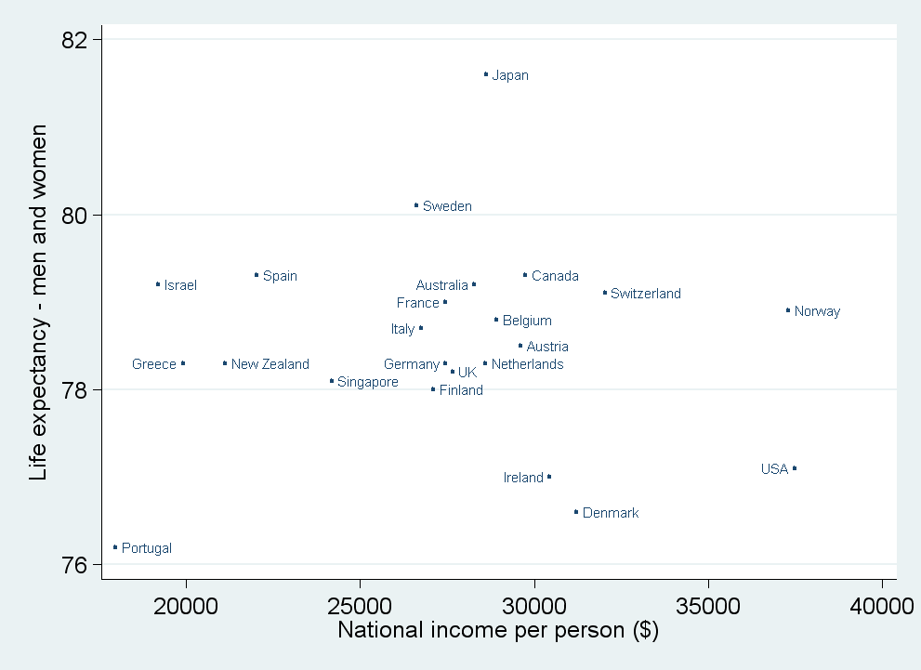
Effects of income between countries
Life Expectancy by Mean National Income
Social problems (violence, mental illness, educational failures have little or no relation to level of average income in between countries).
E.g. Among rich countries life expectancy is not related to national differences in average income.
Some countries are almost twice as rich as others without benefits to life expectancy (on graph)
Source: Wilkinson & Pickett, The Spirit Level (2009)
www.equalitytrust.org.uk

Slide 7
Effect of income within societies
Life Expectancy by Ward Deprivation Score
Within societies, life expectancy is related to income differences within rich countries.
Higher incomes are related to lower death rates
Society is represented in a social gradient that runs across everyone
Health and happiness is related to income. Richer people on the average are healthier and happier than poorer people
Source: Wilkinson & Pickett, The Spirit Level (2009)
www.equalitytrust.org.uk

Slide 8
How much richer are the richest 20% than the poorest 20%?
Income Gap by Country, Selected Developed Nations
Most equal countries on the left
Length of the vertical bar shows how much the richest top 20% are richer than the poorest 20%
The richest 20% in Japan and some Scandinavian countries are less than four times as rich as the poorest 20%
At the right side of the chart, countries like the US the richest 20% get about nine times as much as the poorest
Canada is placed in the middle with the richest 20% getting about six times as much as the poor
Household level figures after tax and benefits adjusted for number of people in each household
Source: Wilkinson & Pickett, The Spirit Level (2009)
www.equalitytrust.org.uk

Slide 9
Why does the amount of inequality matter?
Data shows that with Increasing inequality, the higher is the score on the index of health and social problems.
Health and social problems are more common in countries with bigger income inequality
Health and social problems are more common among the less well-off in a particular society. E.g. Though there are small variance between provinces, if inequality rise, a graph among or within provinces in Canada will likely indicate a positive relationship between health and inequality over time
These health and social problems are within countries but not between countries
There is no difference in relation to average income (national income per person) between countries

Slide 10
What sense can we make from the paradox?/ Wilkinson and Pickett’s Hypothesis
What matters in rich countries is not the income or living standards, but how you compare with other people in the same society--How do I compare with the other guy next to me? It is more about your position in the social pecking order.
Secondly, the social gradient does not result from the effects of relative income or social status on health, but from effects of social mobility. Kind of natural selection- perhaps the healthy tend to move up the social ladder and the unhealthy end up at the bottom.

Slide 11
Snowdon’s Critique & Wilkinson & Pickett’s Rebuttal
Methodological critique
Cherry-Picking Data/Data mining.
1. Exclusion of some of the 50 rich countries
Czech Republic,
South Korea
Hong Kong
2. Exclusion of in the mental health analysis
Singapore
Rebuttal
1. Use of Atlas method of estimation of size of countries in the GNI, selection criteria and the World Bank’s approach were used.
Excluded countries:
with population <3M
without income inequality data from UN.
Selected older, rich developed, market economies
2. As a result of the problematic labelling of mental illness and help-seeking behavior, the World Health Organization’s approach (included drug use) was used
Exclusion of Singapore was based on the assumption that self-reported mental illness will be low because of the death penalty in 1988 given to people in drug related cases.
Inclusion of Singapore does not change the statistical significance of the association

Slide 12
Snowdon’s Critique & Wilkinson & Pickett’s Rebuttal cont’d
1. Homicide is preferable because it is reliably comparable among countries
Comparison of other kinds of crimes are affected by differences in law, reporting and other extraneous factors
2. Countries such as Cuba, Costa Rica and some European countries have life expectancy as high or higher than the US.
E.g. 2006 revision of the UN world population prospects report for 2005-2010
Infant mortality rates 2006
Cuba ------5.1 per 1000 live births
USA--------6.3 per 1000 live births
Canada--- 4.8 per 1000 live births
Life expectancy
Cuba------78.3 years
USA-------78.2 years
Canada—80.7 years
NB: Depends on which data you are using. UN Human Development Report has different figures
Analytical Critique
3. Why is the crime rate not included in the index of health and social problems?
4. Pickett’s Video on “Why Cubans live longer than Americans”

Slide 13
Snowdon’s Critique & Wilkinson & Pickett’s Rebuttal cont’d
5. Other researchers have linked measures of social capital to greater equality
Putnam’s studies in Italian regions and the US show a very strong tendency for the more equal regions and states to have stronger community ties.
The US was more egalitarian in the 50s and 60s, these were also the period of social connectedness and civic engagement. Conversely the last third of the 20th century was a time of growing inequality and eroding social capital.
6. True, however, among rich countries neither is there a relationship between happiness and GNI per head.
The correlation between income and happiness among individuals within countries has been shown to be a relationship with relative income and status. Hence redistribution would improve over-all happiness
Additional income makes much more difference to the happiness to the poor than the rich
NB: both relative and absolute income contribute to happiness not just one.
5. Community life is weaker in less equal countries. When membership to clubs, societies, sports association and religious groups is more common in unequal societies.
6. No existent relationship between happiness and inequality, but a stronger correlation between happiness and income in World Values Survey

Slide 14
Snowdon’s Critique & Wilkinson & Pickett’s Rebuttal cont’d
7. Inclusion of alcohol addiction as a health and social problem, but conspicuously missing in the discussion.
Is it because of the high rates of alcoholism in Scandinavia?
7. Alcohol use and abuse are two different things. The Scandinavian situation can be seen as high alcohol use where consumption is higher among social classes
Alcohol abuse has been include as measured by surveys of mental illness that cover drug and alcohol addiction in the index of health and social problems.
They further demonstrated a significant relationship between death from alcohol-related liver disease and income inequality in US states

Slide 15
I-clicker Question
Which of the following is a major criticism of Wilkinson and Pickett’s book The spirit level” by Snowdon:
Relative income plays a big role in health outcomes
Gross Domestic product is not correlated with good health
A high income gap within society is associated with lower life expectancy
Correlation between relative income and life expectancy is a product of choice of countries
a and c

Slide 16
Critique by other writers
The strength of association between absolute income and life expectancy seems quite sensitive to which countries are included. If more countries are included it changes the association between income and life expectancy (Ken Judge)
Wilkinson findings were an artifact of the selection of countries. The relationship between income inequality and health of the population is slowly dissipating. (Lynch. J et al)

Slide 17
Concluding notes
Which way for the future?
(Wilkinson and Pickett, and Snowdon)?
Food for thought
Almost everything is affected not by how wealthy a society is, but how equal it is
Societies with a bigger gap between rich and poor are bad for everyone in them – including the well off
Everyone benefits from greater equality.
Usually the benefits are greatest among the poor but extend to the majority of the population
There are multiple sources of influence on health and social problems and income and inequality are just a part of the puzzle
Real world differences are very crucial in the analysis of health and social problems.
Social, demographic, historical and cultural differences between nations are very important in the outcome of health and social problems.
Eg. Cultural differences may provide a better explanation of teen birth rates than inequality
Both relative and absolute income are major contributors to health and social problems.
W & P
Sustainability
Greater equality
Economic democracy
Relative income not absolute income offers a better explanation of health and social problems.
Snowdon
Poor housing, unhealthy diet, urban pollution, long working hours and other trappings of poverty offer as much explanation for health and social problems
Use of current and consistent data offers room for unequivocal explanation of health and social problems
Real world differences in countries should be considered in analysis
Absolute income (GDP) not relative income offers a better explanation of health and social problems.

Slide 18
Questions to Ponder over
What are some of the pathways linking income inequality and health and social problems?
Who might be affected by income inequality?
What are the other possible impacts of income inequality, for example, on the economy?

Slide 19
I-clicker Question #2
Which of the following is not a recommended action for rich countries by Wilkinson and Pickett?
Greater equality
Relative income not absolute income offers a better explanation of health and social problems.
Sustainability
Increase in GDP
Economic democracy

Slide 20
Reference
Ken Judge (1995).Income distribution and life expectancy: a critical appraisal. British Medical Journal.
Lynch, P. Due, C. Muntaner & G. Davey Smith (2000). Social capital - Is it a good investment strategy for public health?', Journal of Epidemiological and Community Health.
Snowdon, C. (2010). The spirit level delusion: fact-checking the left's new theory of everything. London: Little Dice.
Wilkinson & Pickett (2010) The Spirit Level: why equality is better for everyone
http://www.un.org/esa/population/publications/wpp2006/WPP2006_Highlights_rev.pdf
http://spiritleveldelusion.blogspot.ca/
http://www.equalitytrust.org.uk/resources/spirit-level
Wilkinson, R. (2005) The Impact of Inequality. Abingdon: Routledge

